Slide 1

BrightCart
E-commerce
BrightCart
Profitability
Analysis
Profitability, Sales Channel & Marketing ROI Analysis
PREPARED BY
DelveTek Interns

Slide 2


02
Problem Statement
BrightCart has experienced strong sales growth, generating over $1 million in gross revenue across multiple products and sales channels. However, despite increasing revenue, profit margins have continued to decline.
This project aims to analyze product profitability, sales channel performance, product returns and marketing effectiveness to identify the key drivers of profitability and provide data-driven recommendations for improving business performance.
WHAT'S THE BUSINESS PROBLEM?
  Declining profit margins despite strong revenue growth.
  Limited visibility into the profitability of products, sales channels, and marketing campaigns.
  Uncertainty about the impact of shipping costs, platform fees, returns, and marketing spend on overall profitability.
  Goal: Identify the key drivers of profitability and recommend strategies to improve business performance.

Slide 3


  Excel
  SQL
  Power BI
  Figma
Approach & Methodology
BUSINESS ANALYSIS
VISUALIZATION & REPORTING
IMPORT & EXPLORE
  Profitability Analysis
  Sales Channel Analysis
  Return & Marketing Analysis
  Create DAX Measures
  Build Power BI Dashboard
  Present Insights & Recommendations
  Import datasets
  Validate Costs
  Data Quality Checks

Slide 4
05
Data Overview
ANALYSIS PERIOD
PRODUCT CATEGORIES
SALES CHANNELS
MARKETING SPEND
01
02
03
04
2 years of comprehensive sales and marketing data from BrightCart
8 distinct product categories sold across all sales channels
4 channels: Website, Mobile App, Marketplace, Social Commerce
$503.51K total spend across multiple advertising platforms
Our analysis examined three key datasets: order-level transactions, a product catalog with cost data for 8 categories, and monthly marketing spend totaling $503.51K across platforms. We focused on true profitability by accounting for all cost factors including shipping, returns, platform fees, and marketing spend.

Slide 5

05
Project Workflow
STEPWISE PROCESS USED FOR PROFITABILITY ANALYSIS
02
04
DATA PREPARATION
DATA ANALYSIS
DATA VISUALIZATION
BUSINESS INSIGHTS & RECOMMENDATIONS
  Imported the three datasets into Excel and SQL.
  Explored the data structure.
  Validated order-level costs.
  Checked for missing values, duplicates, and data inconsistencies.
  Performed SQL queries to analyze product profitability, sales channel performance, return rates, and marketing effectiveness.
  Identified trends, cost drivers, and key business insights.
  Created DAX measures and KPIs in Power BI.
  Built interactive dashboards to visualize profitability, returns, marketing performance, and sales channel metrics.
  Interpreted the analysis results.
  Identified key factors affecting profitability.
  Developed data-driven recommendations to improve business performance and optimize marketing investment.
01
03

Slide 6
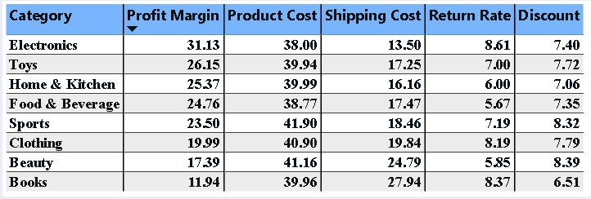
06
Category Profitability
Electronics achieved the highest profit margin (31.1%), while Books recorded the lowest (11.9%). Shipping costs were the main factor reducing profitability in Books, whereas product costs remained relatively consistent across all categories.

Slide 7
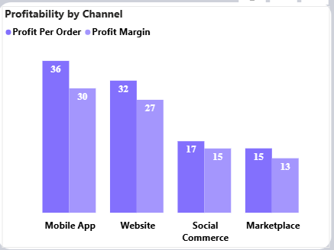
07
Sales Channel Profitability
COMPARATIVE ANALYSIS OF PROFIT MARGINS AND ORDER VALUE ACROSS ALL SALES CHANNELS
The Mobile App was the most profitable sales channel, generating an average profit of 36 per order with a 30% profit margin. Marketplace recorded the lowest profitability (15 profit per order; 13% margin), mainly due to high platform fees despite having the lowest return rate.

Slide 8
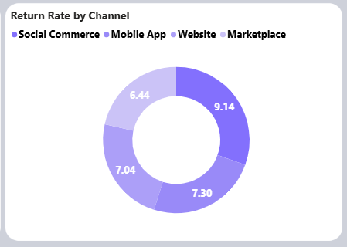

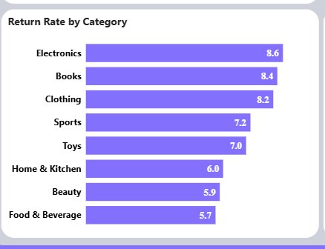
Return Rate Analysis
+$24.98K
LOST REVENUE IMPACT
The overall return rate was 7.2%, resulting in approximately 24.98K in lost revenue. Electronics and Books had the highest return rates, while Marketplace recorded the lowest return rate but remained the least profitable channel, indicating that platform fees and operating costs have a greater impact on profitability than returns.

Slide 9
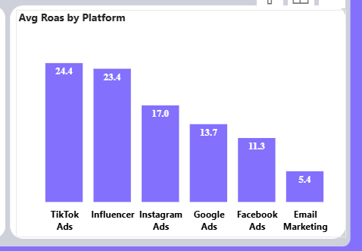
09
Marketing
Performance
AVERAGE ROAS BY MARKETING PLATFORM
TikTok Ads achieved the highest average ROAS (24.4), followed by Influencer Marketing (23.4). Email Marketing recorded the lowest ROAS (5.4), making it the least effective marketing channel. Although Google Ads received a large share of the marketing budget, it delivered a lower ROAS than TikTok Ads and Influencer Marketing.
24.4
TikTok Ads leads with strongest ROAS

Slide 10
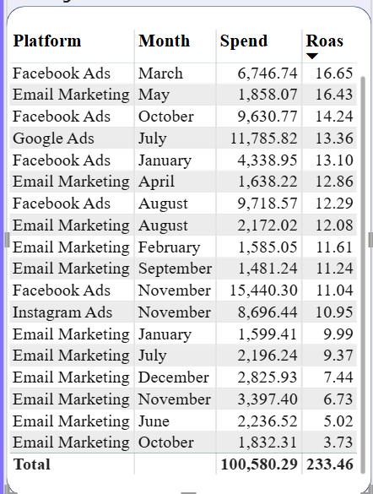
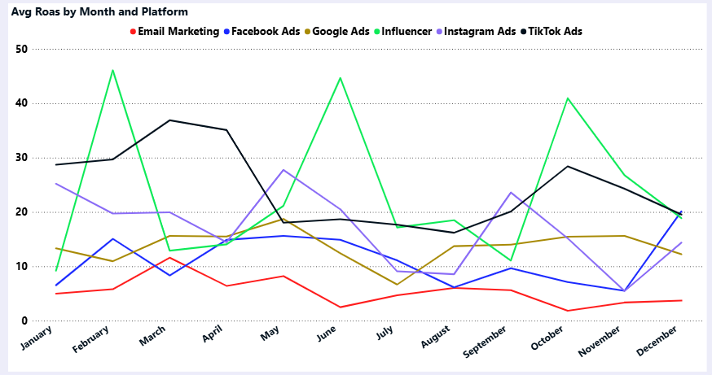
Marketing Budget Optimization
The company spent 503.51K on marketing over the analysis period. A 20% budget reduction equals approximately 100.70K. Based on ROAS performance, Email Marketing and Facebook Ads provide the greatest opportunity for cost reduction without significantly affecting overall returns.

Slide 11

10
Key Insights Summary
SYNTHESIS OF MAJOR FINDINGS FROM BRIGHTCART PROFITABILITY ANALYSIS
Electronics was the most profitable category (31.13%), while Books had the lowest profit margin (11.94%) due to high shipping costs.
Shipping costs were the biggest factor affecting profitability across product categories.
The Mobile App was the most profitable sales channel, while Marketplace generated the lowest profit because of high platform fees.
Returns cause ~$24.98K lost revenue; TikTok Ads and Influencer Marketing deliver strongest ROAS.

Slide 12
11
Shipping & Pricing
STRATEGIES TO REDUCE SHIPPING COSTS AND IMPROVE NET MARGINS
Books category shows lowest profitability at 11.9% margin, with high shipping costs as the primary driver. These recommendations focus on reducing shipping expenses through strategic negotiations and operational improvements.
  Negotiate better shipping rates with carriers
  Optimize packaging to reduce dimensional weight
  Implement minimum order values for free shipping
  Review pricing for low-margin products

Slide 13

Sales Channel Strategy
12
Key Focus
OPTIMIZING CHANNEL MIX AND PLATFORM FEES FOR MAXIMUM PROFITABILITY
STRATEGIC ACTIONS
Our analysis reveals that Website and Mobile App channels deliver significantly higher margins than Marketplace. The key is to shift resource allocation toward these high-performing channels while addressing the structural cost challenges of Marketplace operations.
  Focus marketing efforts on Website and Mobile App channels
  Review and renegotiate Marketplace platform fees
  Explore bundled pricing strategies to offset Marketplace costs
  Develop channel-specific promotions for lowest-margin products

Slide 14
02
Returns Reduction
STRATEGIES TO MINIMIZE RETURNS IMPACT ON NET MARGINS
Electronics and Books show the highest return rates, contributing to margin pressure. Targeted improvements in product quality, descriptions, and customer experience can significantly reduce returns and protect profitability.
  Investigate root causes of returns in Electronics
  Enhance product descriptions and customer reviews
  Improve packaging quality for Books category
  Address Social Commerce return issues

Slide 15

ROAS IMPROVEMENT
Marketing ROI
01
BUDGET OPTIMIZATION
Total marketing spend: $503.51K. Target 20% reduction (~$100.7K) to improve net margins while maintaining growth. Reallocate from low-ROAS platforms to high-performing channels.
02
CUT LOW-ROAS SPEND
Reduce spending on Email Marketing and Facebook Ads, which show the lowest ROAS. These platforms can be downsized without significant impact on overall acquisition.
03
INVEST IN HIGH-ROAS
Maintain or increase investment in TikTok Ads (24.4 ROAS) and Influencer Marketing (23.4 ROAS). Review Google Ads campaigns for improved targeting and efficiency.

Slide 16
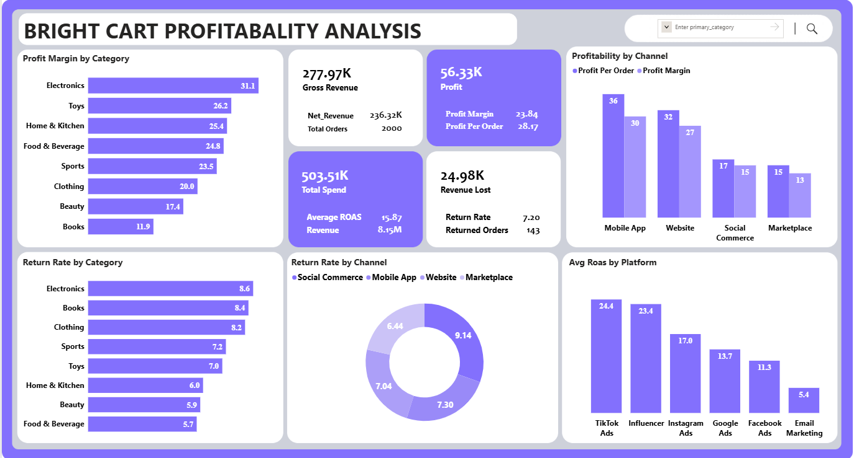
Dashboard Preview
15

Slide 17
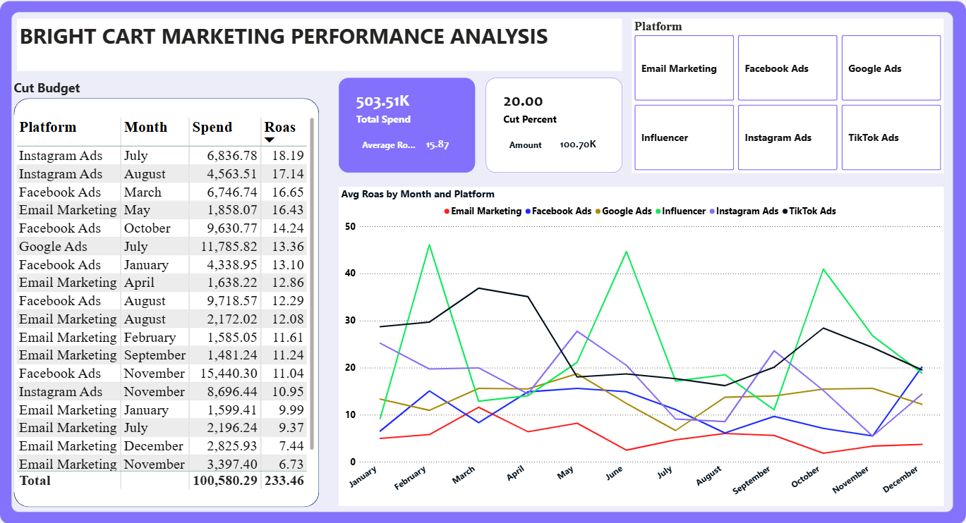
Dashboard Preview
16

Slide 18
CONCLUSION
The analysis shows that cost management, rather than revenue growth, is the key driver of profitability. High shipping costs reduced margins in low-performing product categories, Marketplace profitability was constrained by platform fees, and product returns resulted in approximately 24.98K in lost revenue. Marketing performance varied significantly across platforms, with TikTok Ads and Influencer Marketing delivering the strongest returns. By optimizing shipping costs, reducing Marketplace expenses, minimizing returns, and reallocating marketing spend to high-performing channels, BrightCart can improve profitability and support sustainable business growth.

Slide 19

Thank You!

